Slide 1
Coimbatore MuleSoft Meetup Group
Power of LWC + MuleSoft with PE
[5th June 2021]

Slide 2
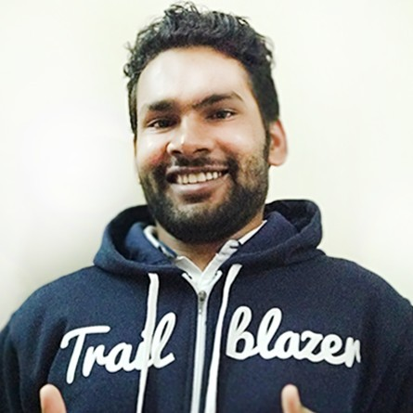
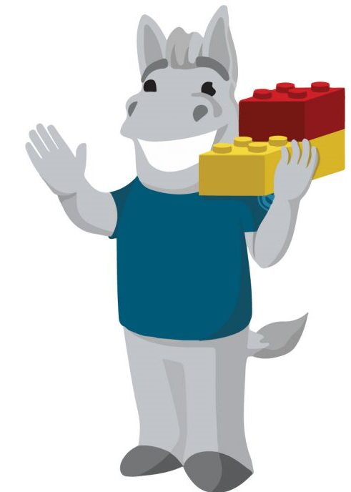
Speaker
About Speaker: AMIT SINGH ( 2X SALESFORCE MVP )
6.7+ years of Technical Experience in Salesforce
2+ Years of Expereince in MuleSoft
16 times Salesforce Certified & MCD1
Faridaba Mule Meetup Leader
Kanpur Salesforce Meetup Chapter leader
Founder of SFDCPanther.com
YouTube at sfdcpanther
Co-Orgnizator at ApexHours
Connect me /in/simplyamit & @cloudyamit / @sfdc_panther

Slide 3


CHEERS..!!
We have prizes to give away!
3 Winners a special prize is ready
A SHOW OF HANDS:
New Members With Us.!!

Slide 4
Agenda
What is LWC ( Introduction in Short )
What are Salesforce Platform Events?
Hands on how to Connect MuleSoft with Salesforce.
Scenario Overview
Live Implementations of the Scenario
Questions & Answers
Quiz
Networking
4

Slide 5
Introduction to LWC ( Lightning Web Component )
Lightning web components are custom HTML elements built using HTML and modern JavaScript. Lightning web components and Aura components can coexist and interoperate on a page
Lightning Web Components uses core Web Components standards and provides only what’s necessary to perform well in browsers supported by Salesforce.

Slide 6
Platform Events
Use platform events to connect business processes in Salesforce and external sources through the exchange of real-time event data.
Platform events are secure and scalable.
Define fields to customize your platform event data.
Platform Event works on Event Driven Architecture
A message can stay in the event bus for max up-to 72 hours
You can not retrieve platform Events using SOQL

Slide 7
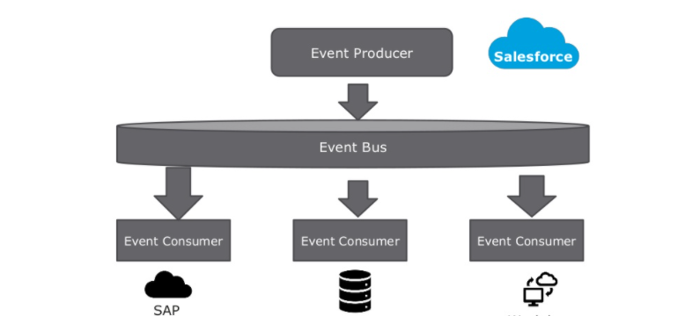
Event Driven Architecture ( Publish subscribe )

Slide 8
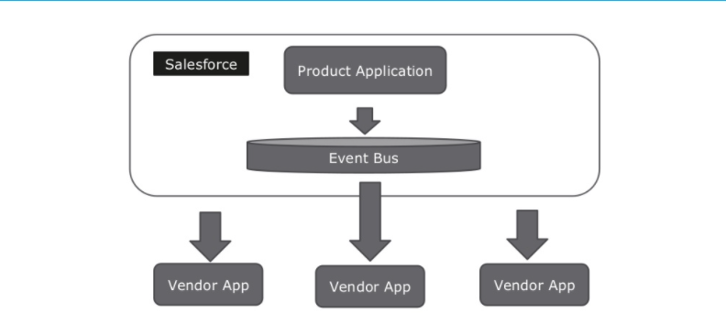
Order Management ( Salesforce to App )

Slide 9
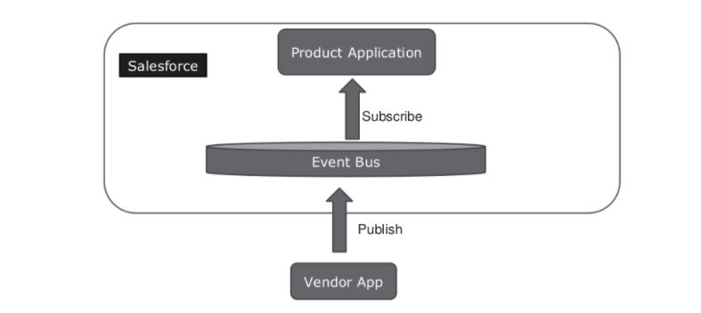
Order Management ( App to Salesforce )

Slide 10
Components of Event-Driven Systems
Event - A change in state that is meaningful in a business process.
Event message - A message that contains data about the event. Also known as an event notification.
Event producer - The publisher of an event message. For example, an order placement app.
Event channel - A stream of events on which an event producer sends event messages and event consumers read those messages.
Event consumer - A subscriber to a channel that receives messages from the channel.
Event bus - A communication and storage service that enables event streaming using the publish-subscribe model. The event bus enables the retrieval of stored event messages at any time during the retention window.

Slide 11
Connect MuleSoft with Salesforce

Slide 12
Scenario Overview
You are working as an Integration developer for a company called AWB Computing. AWB Computing is a dealer of parts of heavy vehicles. The sales representatives needs a functionality to check if the customer is eligible for discount or not and if eligible then what amount.
The big problem is that Sales reps are in salesforce and the discount details related to those customers are sitting inside an external database. Currently sales resp needs to pull a report and then find the correct customer to see if the customer is eligible or not and sometimes there are errors as well.
To help the reps you need to develop a solution which will make the sales rep task easy.

Slide 13
Solution Overview
Your architect team have came up with a solution that they will use below component as part of solution.
Platform Event to send the Custom Information & Platform event to get the discount details
MuleSoft listening the Platform Event, Checking the Discount Details and again publishing the Platform Event.
Lightning Web Component for the user interface where sales rep can provide customer details and see the discount details.

Slide 14
Live Demo

Slide 15
References
https://developer.salesforce.com/docs/atlas.en-us.platform_events.meta/platform_events/
https://trailhead.salesforce.com/modules/platform_events_basics
https://help.salesforce.com/articleView?id=platform_events.htm&type=5
15

Slide 16
Q&A

Slide 17

Quiz Time
Get ready to WIN a Special Gift from MuleSoft Community

Slide 18
Question 1
Requests in a composite call are called...?
a. Subrequests
b. Duplicaterequests
c. Childrequests
d. None of the Above

Slide 19
What’s next?
Share:
Tweet your pictures using the hashtag #SuratMuleSoftMeetup
Invite your network to join: https://meetups.mulesoft.com/surat/
Feedback:
Fill out the survey feedback and suggest topics for upcoming events
Contact MuleSoft at meetups@mulesoft.com for ways to improve the program
Reach out to either Jitendra Bafna or Nitish Jainto suggest topics for next Meetup

Slide 20
Thank you

